Slide 1

UDPS 2133 Mathematical Programming
Topic 2:
Markov Chains

Slide 2
Stochastic Process?
A stochastic process to observed the characteristic of a system .
A description of the relation between the random variables.
Discrete Time
Continuous Time
Observe the system characteristic of random variable at discrete point in time.
Observe the state of system characteristic of at any time.

Slide 3
Markov Chains?
Discrete-time stochastic process
= p_{ij}
the probability distribution of the state at time t + 1 depends on the state at time t (i_{t}) and DOES NOT depend on the states the chain passed through on the way to i_{t} at time t.
Stationarity assumption [probability law remain stationary (unchanged)]
Transition probabilities (from state i → state j)
Notes:
Stationarity Assumption: Probability law relating the next period’s state to the current state does not change over time, or remain stationary.
Stationary Markov Chain: Any Markov chain that satisfies P(X_{t}=1 = j | X_{t} = i) = p_{ij}

Slide 4
Transition Probability Matrix
j
i
Each entry in P matrix MUST be nonnegative
The initial probability distribution for the chain is in state i at time 0: P(X₀ = i) = q_{i}

Slide 5
Gambler’s Ruin
t = 0, capital, X₀ = $2. At t = 1, 2, …, U bet $1 in each game.
Probability to win : p probability to lose : 1 − p
Goal : increase capital to $4
Stop : Goal is achieved or capital reduced to $0
X_{t} = total capital after the time t game is played
Notes:
If the state is $0 or $4, I don’t play the game anymore, so the state cannot change; hence, p₀₀ = p₄₄ = 1

Slide 6
Gambler’s Ruin
Graphical Representation
1 − p
p
1 − p
p
0
1
2
3
4
1
1
1 − p
p

Slide 7
Choosing Balls from an Urn
Head
Paint red
t = time after coin flipped for t^{th} time and painted a ball
Toss coin
Choose 1
Tail
Paint black
unpainted
Possible States: #. painted ball in urn
[u r b]
[2 0 0] [1 1 0] [1 0 1]
[0 1 1] [0 2 0] [0 0 2]
painted
Red
Black
Toss coin
change to
Head
or tail
Black
Red

Slide 8
Choosing Balls from an Urn
 | Event | Prob
[1 1 0] to [0 1 1] | Chosen unpainted ball, flipped tail | ½ × ½
[1 1 0] to [0 2 0] | Chosen unpainted ball, flipped head | ½ × ½
[1 1 0] to [1 0 1] | Chosen red ball, painted to black | ½

Slide 9
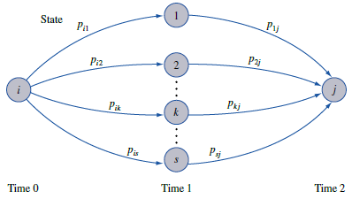
n-step Transition Probabilities
= P_{ij}(n)
n-step probability of a transition from state i to state j

Slide 10
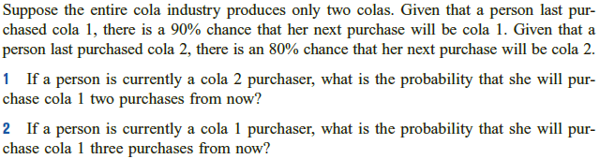
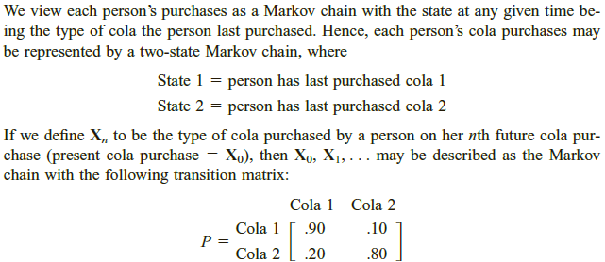
Coca-Cola
The initial probability distribution, probability of customer who will choose cola 1 or cola 2 at the beginning, unknown!

Slide 11
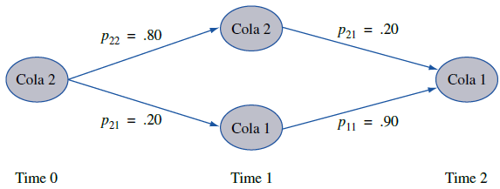
Coca-Cola
1
2
P₂₁(2) = 0.34
The probability that 2 purchases in the future a cola 2 drinker will purchase cola 1 is 0.34.

Slide 12
Coca-Cola
1
1
P₁₁(3) = 0.781
The probability that 3 purchases in the future a cola 1 drinker will purchase cola 1 is 0.781, ≈78%.

Slide 13
Probability of system in state i at time n
Probability of being in state j at time n
=
=
= q×(column j of P^{n})
q = [q₁ q₂ … q_{s}]

Slide 14
Probability of system in state i at time n
Initial probability distribution
Suppose 60% of all people now drink cola 1, and 40% now drink cola 2. Three purchases from now, what fraction of all purchasers will be drinking cola 1?
q = [0.6 0.4]
∴ 3 purchases from now, 64% of all purchasers will purchase cola 1.
1

Slide 15
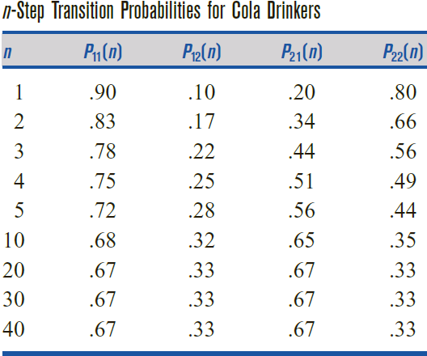
Steady State
Steady State

Slide 16
Classification of States
1 is reachable from 2
2 is reachable from 1
Path exists from 1 to 1, 1 to 2
2 to 1, 2 to 2
Path
Reachable
Communicate
Transient state
Recurrent state
1 & 2 communicate,
3 & 4 communicate,
4 & 5 communicate.
0
1
2
3
4
Path exists from 3 to 3, 3 to 4
4 to 3, 4 to 4, 4 to 5
5 to 4, 5 to 5
3 is reachable from 4, vice versa
4 is reachable from 5, vice versa
If path exist from 2 to 4, but not 4 to 2,
then 2 is a transient state.
Opposite of transient = recurrent (such as state 0 and 4)
Notes:
State 1, 2, and 3 are transient state,
State 0 and 4 are recurrent state

Slide 17
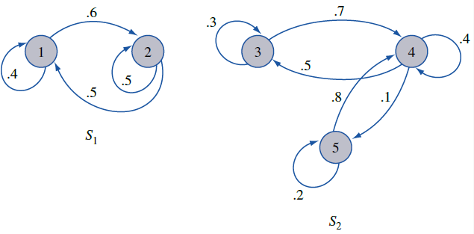
Classification of States
Closed set
No outside state reachable from this set of state.
Absorbing state
p_{ii} = 1
Periodic
Aperiodic → non periodic recurrent state
State i has period k (smallest no.) if all path leading from state i back to state i have a length with multiple of k
State 1 has period 3
(1→2→3→1)
**Absorbing state is a closed set
**Absorbing state can be recurrent states
State 2 and 4 are absorbing state

Slide 18
Classification of States
Ergodic
All states are:
recurrent, aperiodic, communicate
Ergodic
Non-ergodic

